Slide 1
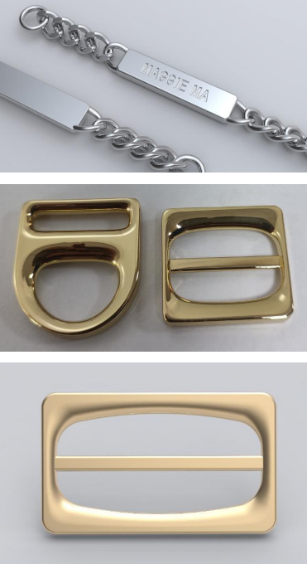

Table of Contents
Catalogue
Company Profile
Services
Products
Clientele
Contact us

Slide 2



0 1
01
01
01
01
Company Profile
PART ONE

Slide 3
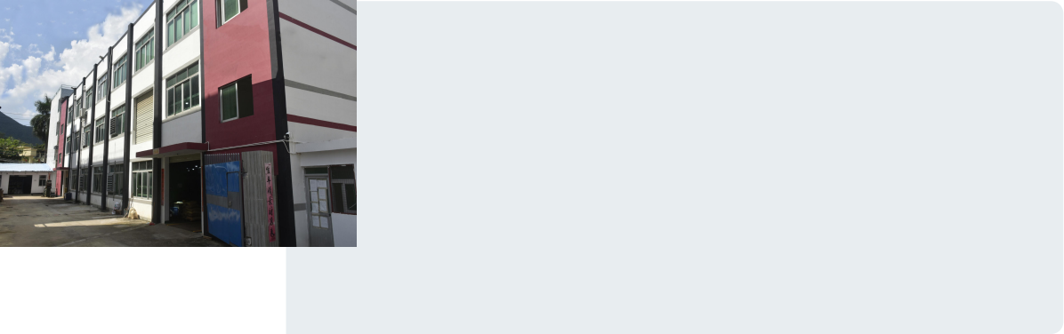
Company was founded in 2013, with plant covers an area of 7000 square meters, there are 100 automatic punching machines, zinc alloy die-casting machine 3 sets, automatic mold opening equipment 5 sets, inspection equipment 3 sets! Specialized mass manufacturing: spring snap button, prong snap button, jeans button, eyelet, rivets, zinc alloy, resin button, etc. Annual production of 1 billion pieces of various buttons, according to customer requirements to develop variety of fashion trends of hardware and resin buttons.
We have professional technical team, can provide customers with quality products and sincere service; Today, Henglida has served hundreds of international and domestic famous brand clothing, handbags, shoes and other enterprises, product quality meets international testing standards, and the lead content of buttons meets international standards of 90ppm!
Establishment time
2013-now

Slide 4
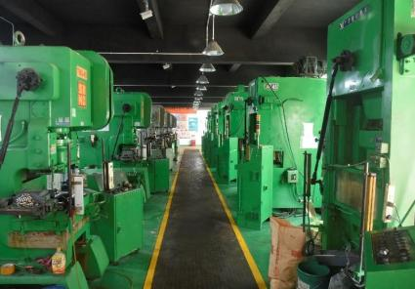
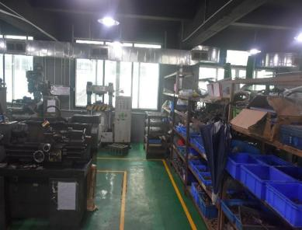
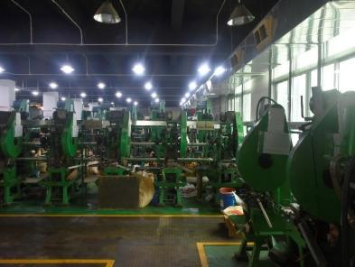
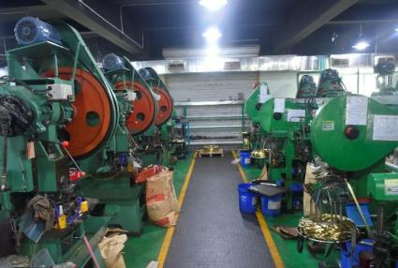
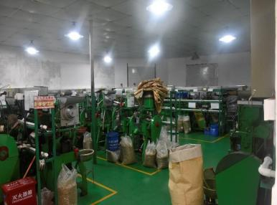
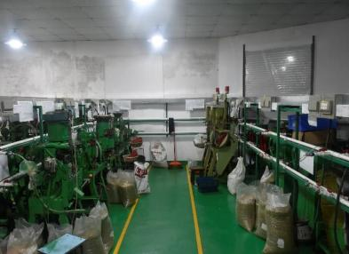
At present, the factory covers an area of 7000 square meters, with 80 automatic presses, 12 large high-speed presses, 3 zinc alloy die-casting machines.
Company Profile

Slide 5
0 2
01
01
01
01
Products and Services
PART TWO

Slide 6



Products and Services
Quality Service
Our company has always been adhering to the customer first service purpose! Quality service is my commitment, to make you satisfied is my pursuit.
As a reliable partner,we pursue innovation, customer first and perfect as the highest goal.
Excellent Quality
Factory production operation is strict, from the raw material procurement, have been strictly tested, in the production process of multiple quality inspection, roll-electric products in the final product packaging before sampling, hanging products 100% full test before packaging and shipping.

Slide 7

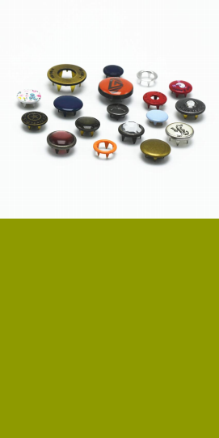
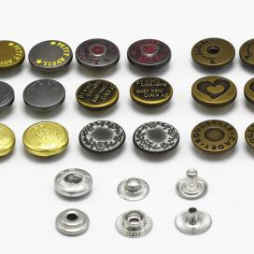

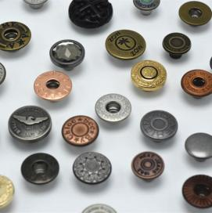
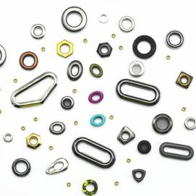
Product Introduction
Products & Services
Prong snap button
Beautiful and generous, not only can be engraved on the button surface of a variety of exquisite patterns and brand trademarks, but also through the use of a variety of surface treatment means, can adapt to a variety of colors of clothing fabrics. Mainly used in knitting, underwear, shirts, pajamas, children's crawl suit and other clothes.
Stud button
Also known as jeans button, it is composed of two parts: the upper button (side A) and the lower nail (part B), which is generally suitable for denim clothing. Jeans button classification: single pin button, nylon insert jeans button, double pin button, etc. Cap style can be customized LOGO according to customer requirements.
Spring sanp button
Commonly known as snap button, spring button, sewing button. Snap button is combined with the S-type spring, and is divided into four parts ABCD from top to bottom: AB is called the female button, and the button surface can be engraved with patterns; The CD piece is called the male button, which creates an opening force with the female button to fix the clothing. The spring button is suitable for all kinds of clothing and bags.
Eyelet
Accessory name, also called eyelets rivets, hollow rivets, shoe eyes. Mostly metal materials, occasionally plastic products, used for clothing accessories, mostly used for the export of casual clothing hats equipped with drawstrings, and can also be directly used as decoration for clothing surfaces.

Slide 8
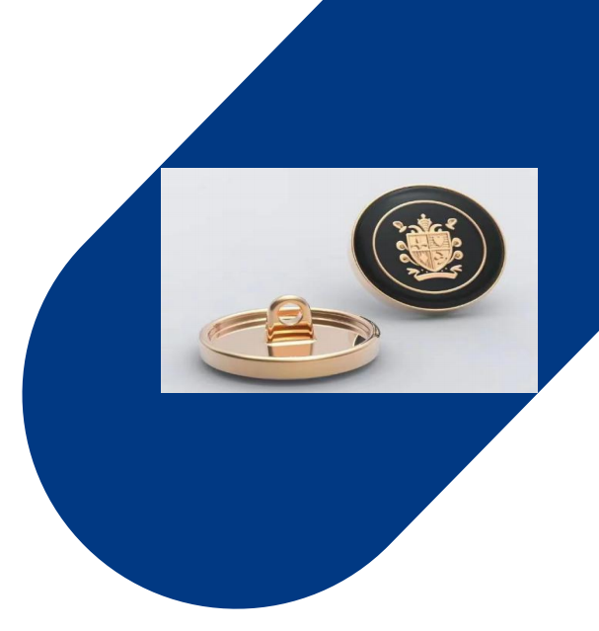
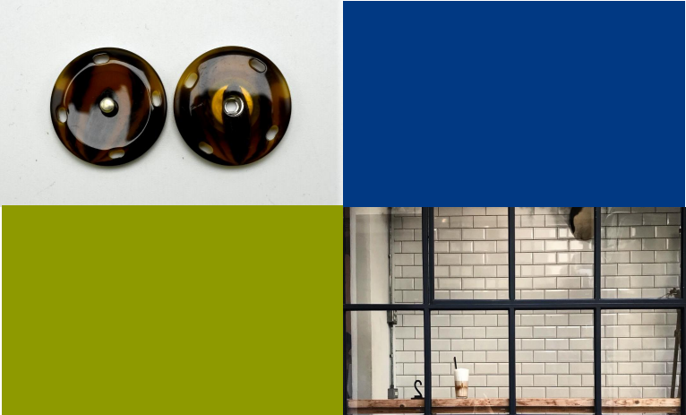
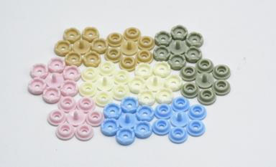
Product Introduction
Plastic snap button is made of POM material, which is environmental friendly and healthy, and has the characteristics of good wear resistance, high temperature resistance and chemical resistance. It is widely used in kid's clothing.
Resin buttons are made of unsaturated polyester resin. It replaces the previous plexiglass buttons. The surface of resin buttons is bright and clean, and the colors are rich and diverse. The patterns and shapes of buttons can be produced according to customer requirements.
Hand sewing buttons are sewn on clothes with needles and threads. It can connect clothes and make people neat. The unique hand sewing button will also have an effect on the starting point of clothes. According to the material, it can be divided into: copper, alloy, resin, plastic, wood, etc.

Slide 9
Partial Product Display

Slide 10
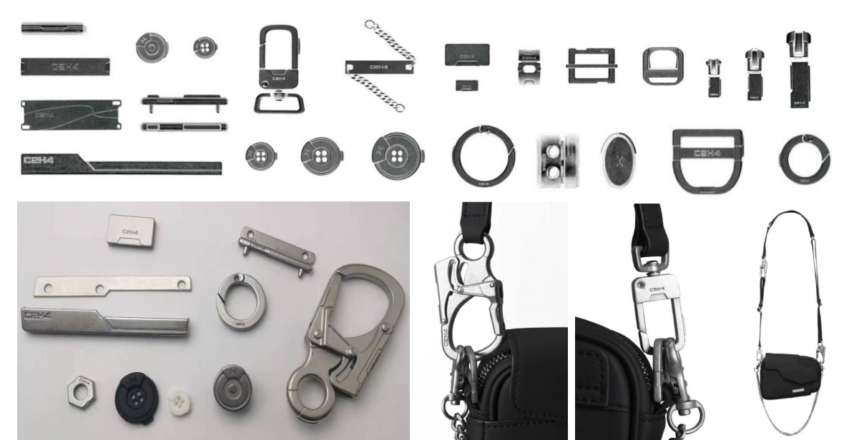
C2H4 Brand Series Part 1

Slide 11
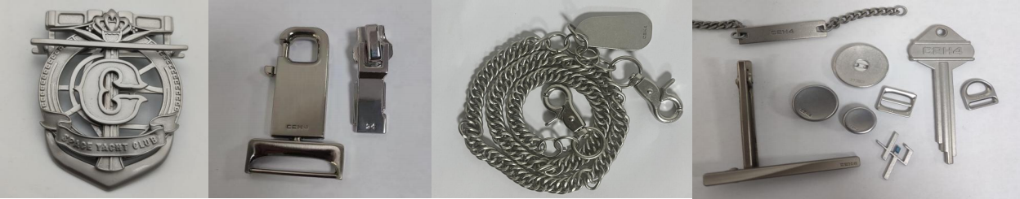
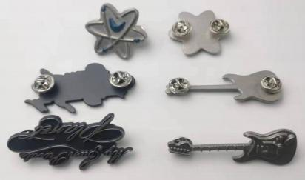
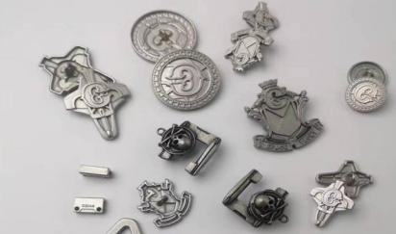
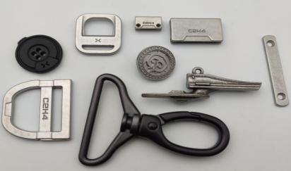
C2H4 Brand Series Part 2

Slide 12
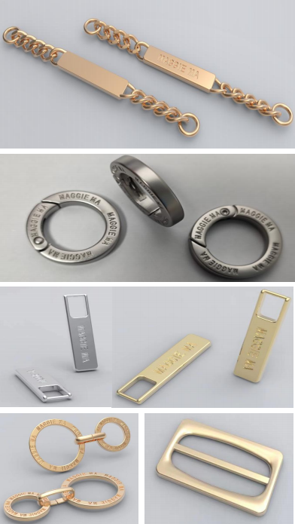
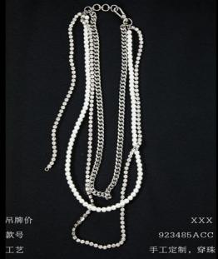
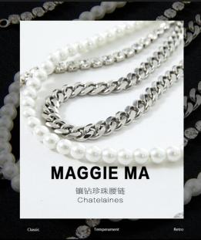
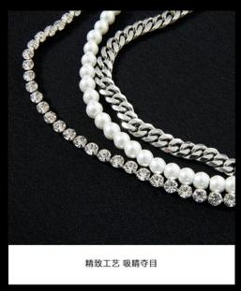
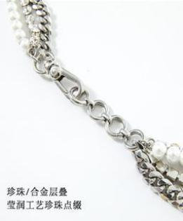
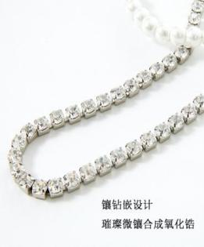
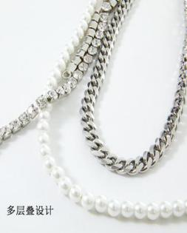
MAGGI3 MA Brand Series

Slide 13
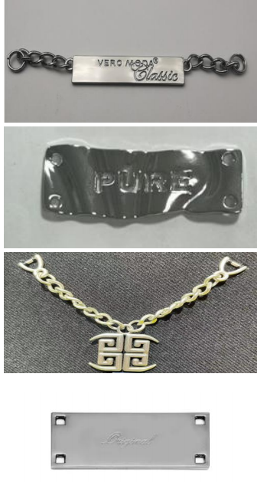
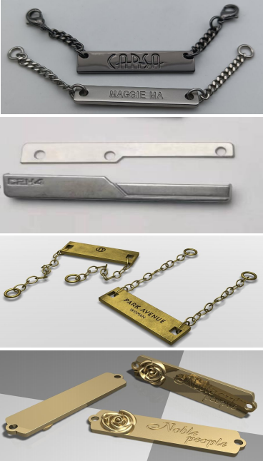
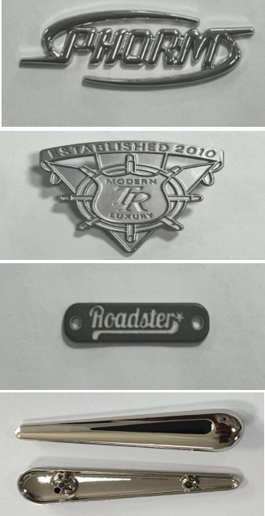
Metal Ornament Series

Slide 14
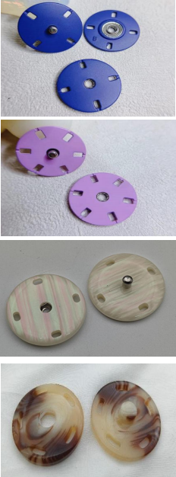
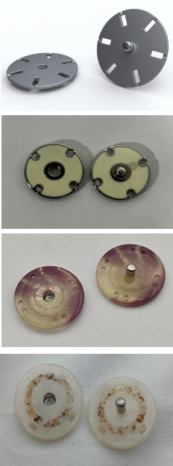
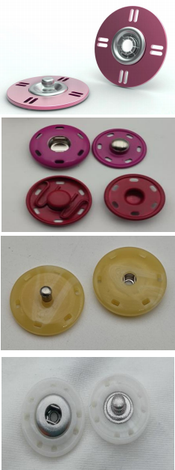
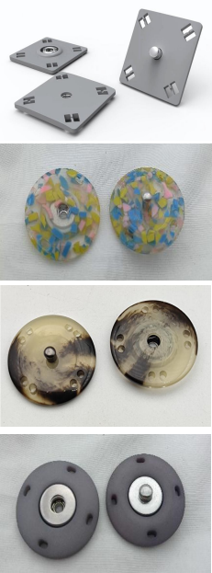
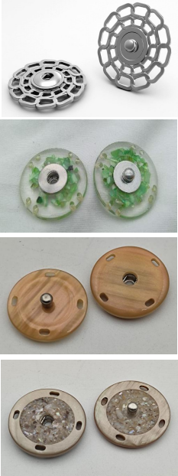
Sewing Button Series Part 1

Slide 15
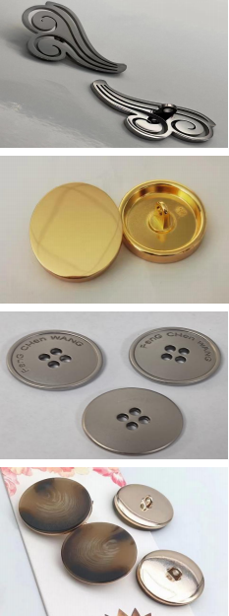
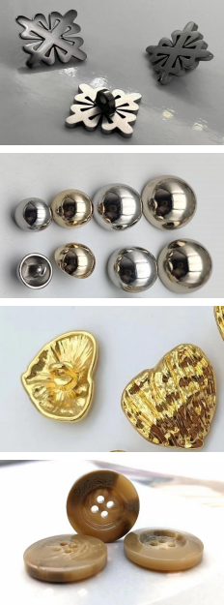
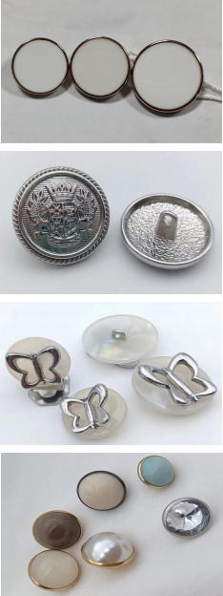
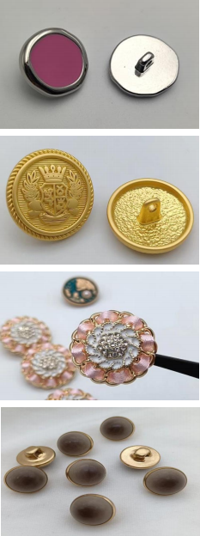
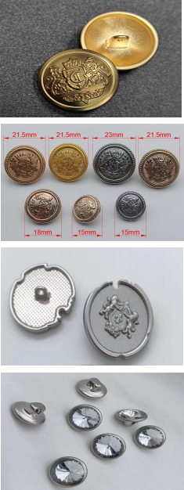
Sewing Button Series Part 2

Slide 16
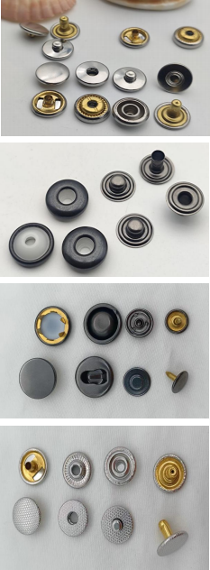
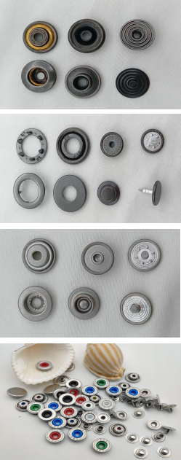
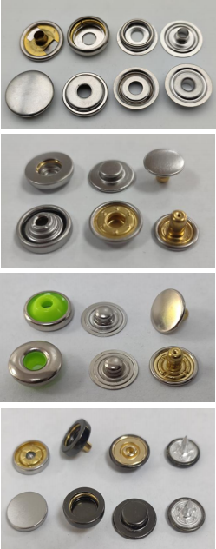
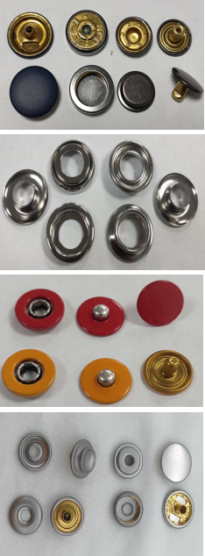
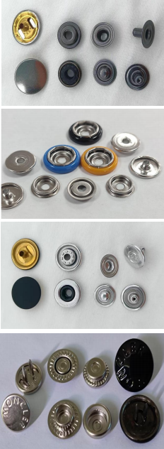
gSpring Snap Button Part 1

Slide 17
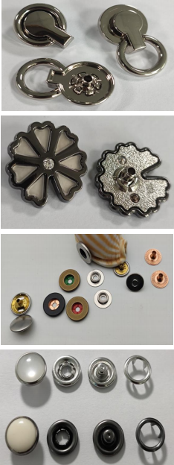
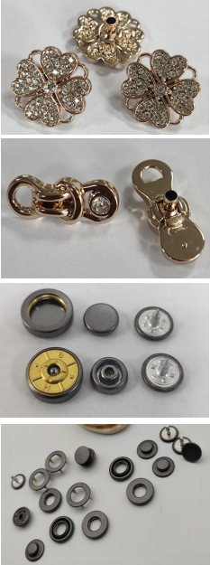
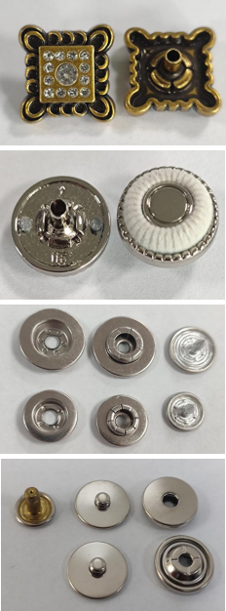
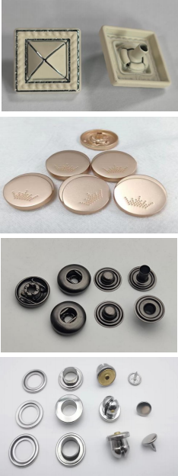
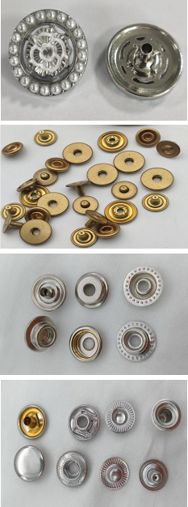
gSpring Snap Button Part 2

Slide 18














Metal Ornament Series

Slide 19





Jeans Button,Rivets,Eyelet Series

Slide 20














Trademark leather series

Slide 21
03
0
0
0
1
1
Clientele
PART THREE

Slide 22














Clients

Slide 23
04
0
0
0
1
1
Contact us
PART FIVE

Slide 24




Contact us
Tel： +923110213230
Inbox：s.faizanai1994@gmail.com
Address : Karachi Shahrafaisal
Company Add：No.58 South Baisha Road, Humen Town, Dongguan City, Guangdong Province

